Slide 1
Health and Wholeness
Topic 4: Nutrition

Slide 2
Nutrition is the process of taking in nutrients/ food values to the body.
We either take in these nutrients rightly or not.
When you take them in rightly, it’s known as a Balanced diet while if not, it’s known as malnutrition

Slide 3
Nutrients are grouped into macro and micro nutrients
Macro nutrients:
you need a lot of them
Water
Carbohydrates
Fat
Protein
Micro nutrients:
small but important!
Vitamins
Minerals

Slide 4
People need a balanced diet
A balanced diet means people eat the right amount of the right type of food as required by the body at a particular (right) time.

Slide 5
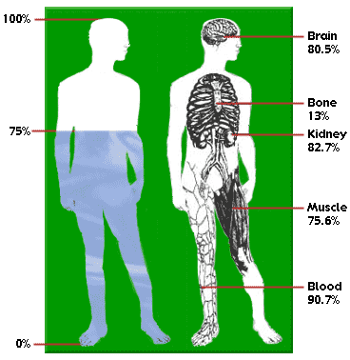
Water: 75% of your body!
Necessary for all body functions
Regulates temperature
Carries other nutrients through body
Keeps tissues moist
Used in every cell, sweat, or tear drop

Slide 6
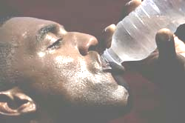
You need to DRINK WATER
DRINK 2-3 LITRES PER DAY (or more)
We lose water in urine, sweat, breathing

Slide 7
Under drinking leads to dehydration
Thirsty? You are already dehydrated!
Leads to headaches, apathy, fatigue
Serious dehydration is deadly
Children at high risk
  Have less water to spare
  Don’t know they are dehydrated

Slide 8
Carbohydrates (sugars) energy giving foods
Sources: staple foods - rice, posho, matooke, millet, cassava, potatoes
Simple: refined, e.g. table sugar, candy, sodas – burst of energy, finishes fast
Complex: chains of simple sugars,
  Starch (rice, millet, maize etc) burns slow, important
  Fiber - green leafy veggies, fruits, grain

Slide 9
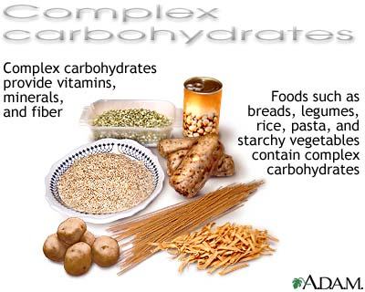
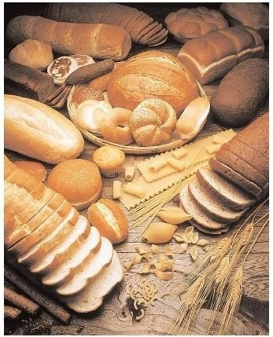
Complex Carbohydrates

Slide 10

Fats (fatty acids)
Store energy, help process vitamins
Found in meat, milk, cheese, nuts

Slide 11

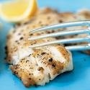
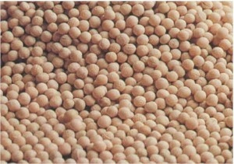
“Essential” fatty acids
Build cells
Come from fatty fish, soybeans, sunflower

Slide 12
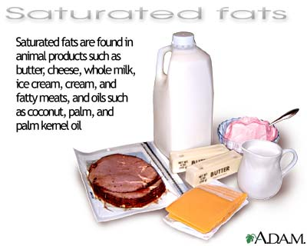
Saturated and unsaturated fats
Based on how much hydrogen they have
Saturated: generally solid at room temp
Unsaturated: liquid at room temp
Partial: ‘trans fats’ are a serious risk

Slide 13

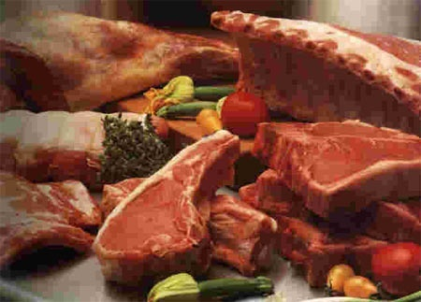
Proteins: Groups of “Amino Acids” Body building foods
For skin, muscles, growth; all body systems
Bodies have 20 amino acids, 9 are ‘essential’

Slide 14
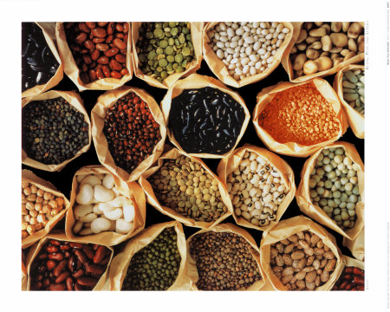
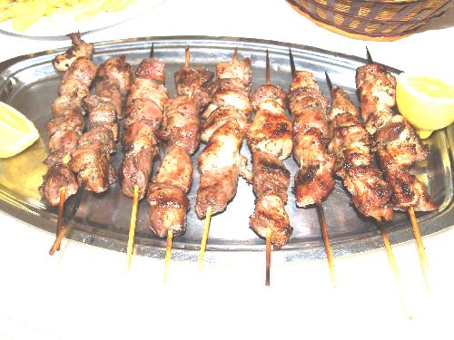
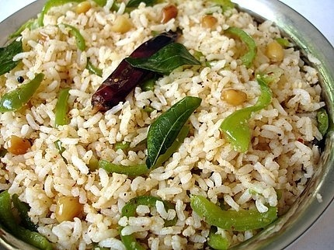
Proteins: Complete, Incomplete
Complete: all 9 essential (from animals)
Incomplete: have some (from plants)

Slide 15
Micro Nutrients:
Vitamins, Minerals
Mix with other chemicals for specific body functions
Vitamins
  organic, found in vegetables and fruits
  Letters like A, B, C, K
Minerals: inorganic, exist in water and soil (not created in plants)

Slide 16
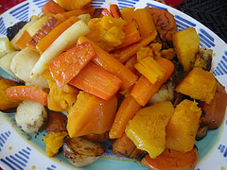
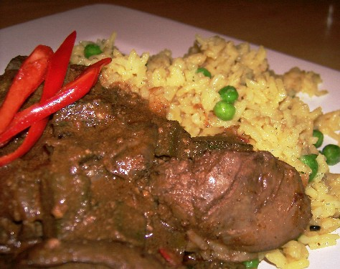
Vitamin A: Liver, yellow veggies
Great for immune system and vision

Slide 17
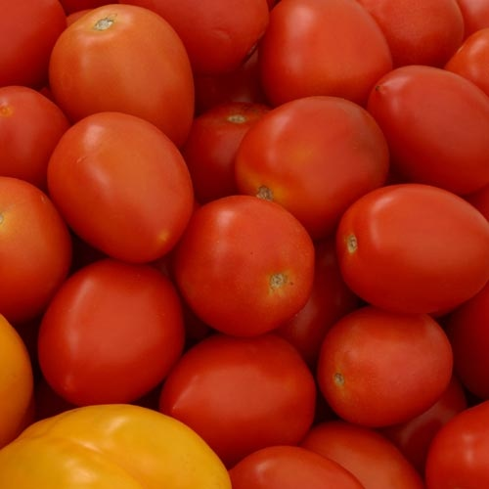
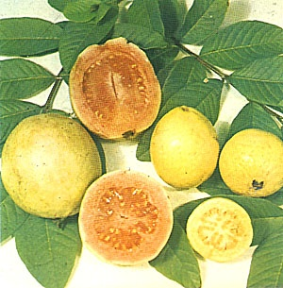
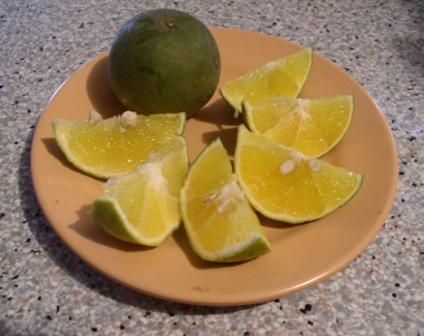
Vitamin C
Builds bones, teeth, fights infection

Slide 18
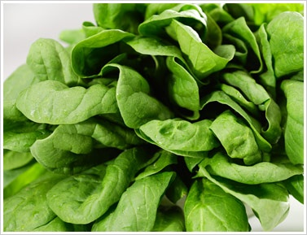
Iron: Liver, green leafy veggies
Makes red blood cells, especially important for women and girls

Slide 19
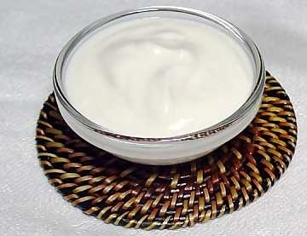
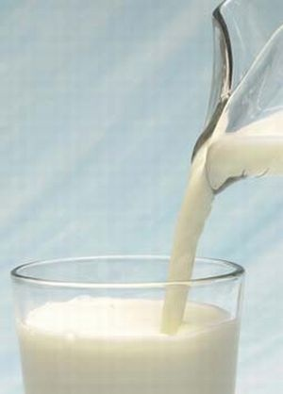
Calcium: Yogurt, milk, cheese
Good for bones, teeth

Slide 20
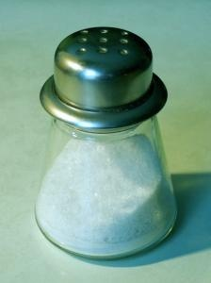
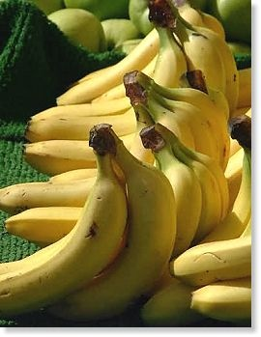
Salts: Sodium and Potassium
Helps regulate water content in cells
Careful: not too much salt!

Slide 22
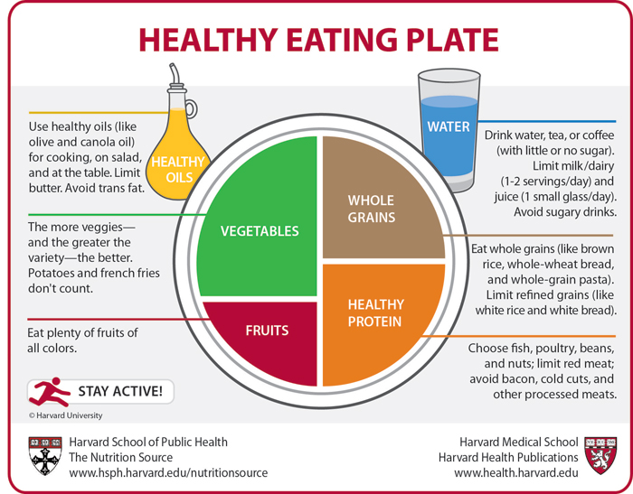

Slide 23
Calories: a measure of energy
Eating: Adds calories
Work, exercise, etc: Spend calories
Eating > Work = Gain Weight
Eating < Work = Lose Weight
1 gram Carbohydrate = 4 Calories 1 gram Protein = 4 Calories 1 gram Fat = 9 Calories

Slide 24
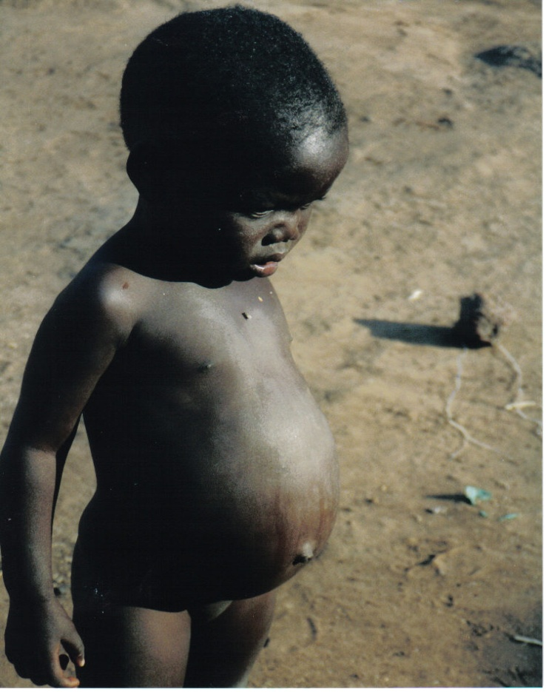
Problems of Under Eating
Kwashiokor: apathy, swelling, hair loss or colour change, loss of appetite, increased disease, weight loss, slow growth
Mirasmus: wasting, bloated belly, but alert

Slide 25

Problems of Over Eating
Gain weight
Strains body, limbs
High blood pressure
Heart disease
Diabetes

Slide 26
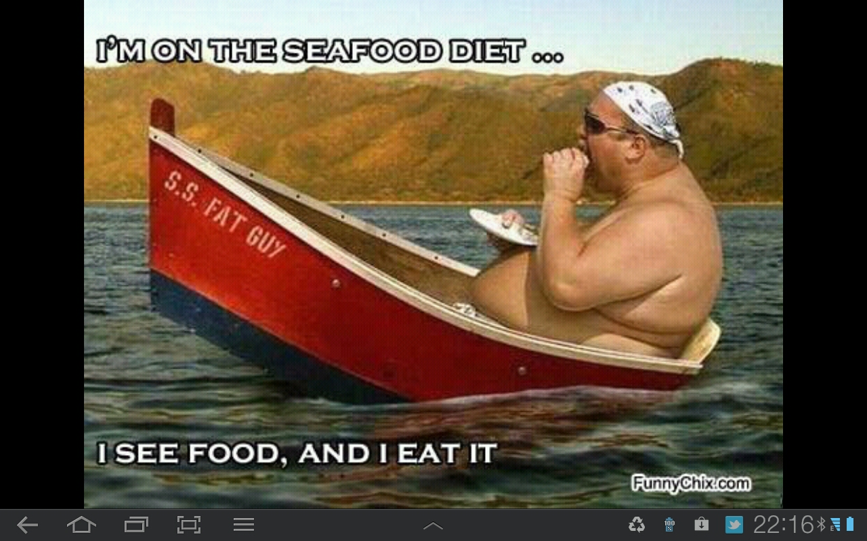

Slide 27
Are you Under / Over Weight?
Body Mass Index:
Weight (kg) / Height (m)²
Example: 70kg and 1.8m
  70 / (1.8x1.8) = 70 / 3.24 = 21.6
< 18.5 may be underweight
>25 may be overweight
>30 may be obese

Slide 28
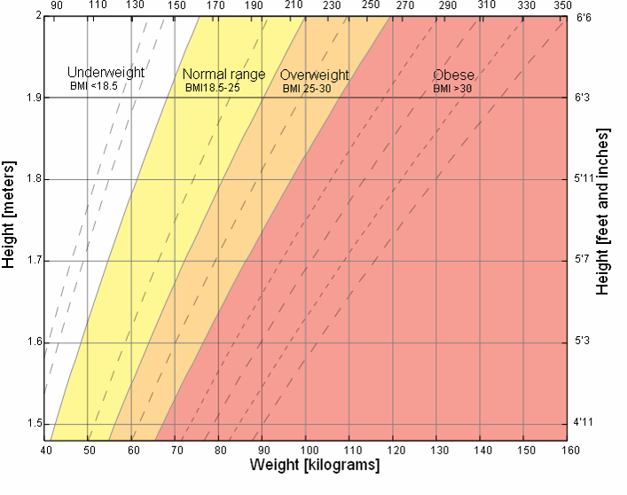

Slide 29
Waist-to-heap ratio
Male
Female
0.95 or below – low risk
0.96 to 1.0 Moderate risk
1.0 + High risk
0.80 or below – low risk
0.81 to 0.85 Moderate risk
0.85 + High risk

Slide 30
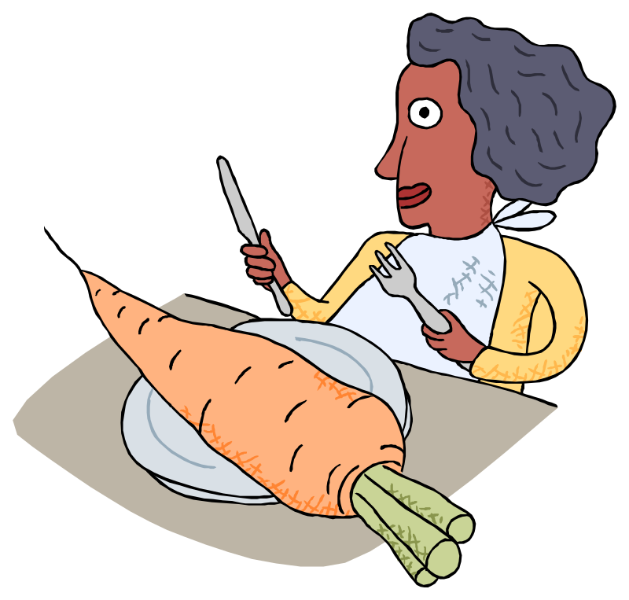
Important lessons for balancing diet
2-3 handfuls of veggies/fruits daily
Avoid high fat food: sausage, chap, chapati

Slide 31
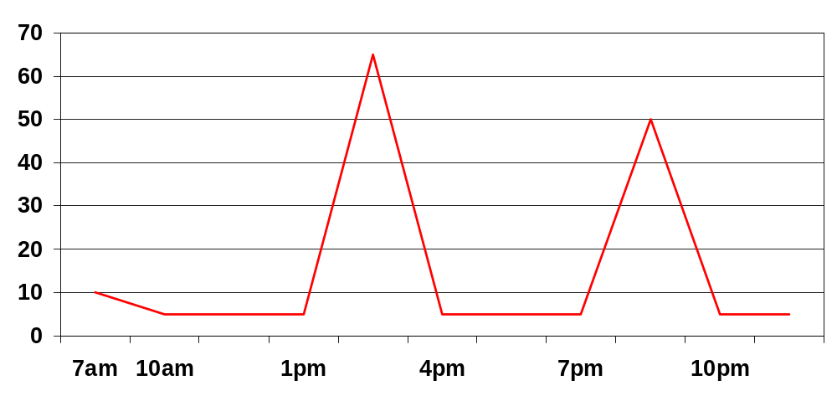
Typical pattern: spikes energy

Slide 32
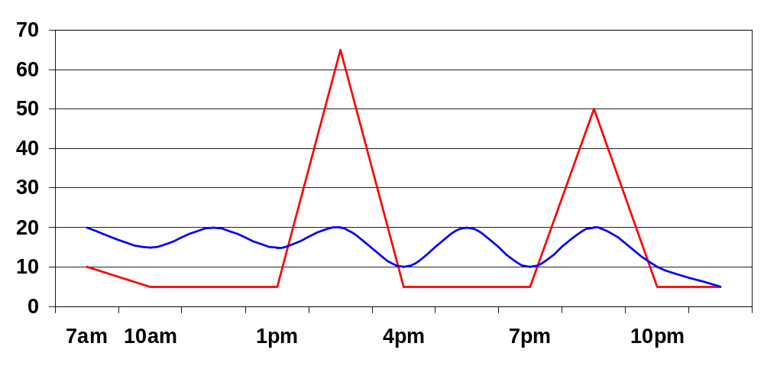
More meals: Smoother energy

Slide 33
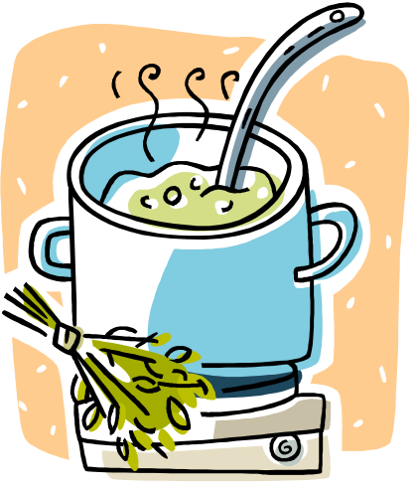

How you cook matters
Overcooking/boiling vegetables looses their nutrients
Frying adds unnecessary fat
Adding oil: calories for the under-fed, but NOT good for the middle class!

Slide 34
The Whole Truth
Deuteronomy 8:2 Remember how the LORD your God led you all the way in the desert these forty years, to humble you and to test you in order to know what was in your heart, whether or not you would keep his commands. 3 He humbled you, causing you to hunger and then feeding you with manna, which neither you nor your fathers had known, to teach you that man does not live on bread alone but on every word that comes from the mouth of the LORD.

